Slide 1





Zerto DRaaS & Intra Cloud Architecture
For each customer & cloud vCenter/SCVMM Zerto Virtual Manager (ZVM) & VRAs Install in minutes
Manager of managers
Zerto Cloud Manager
vCD, multi-tenancy, resource mgmt
Customer A
DRaaS Cloud
BC/DR Cloud
vCenter
ZVM
VM
VRA
VM
VRA
vCenter
ZVM
ZCM
ZVM
vCenter
ZCC
vCD
VPN, MPLS
ZCC
Customer B
VRA
VRA
VRA
VRA
SCVMM
ZVM
VM
VRA
VM
VRA
For DRaaS multi-tenancy, 1 per customer
Zerto Cloud Connector (ZCC) 2 IPs, 1 customer facing 1 replication network
Deploy dedicated port group Zerto Cloud Replication Network
Standard or distributed switch

Slide 2
How to grant O2M/LTR features to the Customer
Required:
CSP must have a CloudO2M license
Customer ZVM must have a DRaaS-E license
How does the customer get a DRaaS-E license?
CSP must register the ZORG on the Tenants Portal with a Product Type of Mulitcloud
Once this is saved, it will send a Saleforce task to the Cloud Architect to create the DRaaS-E license.
The Cloud Architect creates and sends the license to the CSP, who then implements that on the customer ZVM (site settings)

Slide 3
CSP Licensing Scenarios

Slide 4
DRaaS use case 1 Local copy for DRaaS customer using O2M

Slide 5

Scenario 1.1: Local copy
DR-Site managed by CSP
On-Premise Hypervisor based
DR site with CloudO2M license
Site-1
ZVM
ZCC
ZCM
DRaaS-E sublicense
ZORG required
UNDER NDA – ZERTO Private and confidential
Notes:
Most popular use case: loopback copy

Slide 6
Scenario 1.2: Copy to another Enterprise site
DR-Site managed by CSP
On-Premise Hypervisor based
DR site with CloudO2M license
Site-1
ZVM
ZCC
ZCM
DRaaS-E sublicense
ZORG required
Site-2
DRaaS-E sublicense
UNDER NDA – ZERTO Private and confidential
Notes:
Local copy to another enterprise site

Slide 7
DRaaS use case 1.3 Multiple copies for DRaaS customer using O2M

Slide 8
Scenario 1.3: Multiple copies to two CSP sites (multi-geo)
DR-Site managed by CSP
On-Premise Hypervisor based
DR site with CloudO2M license
Site-1
ZVM
ZCC
ZORG required
ZCM
DRaaS-E sublicense
DR site with CloudO2M license
Site-2
ZVM
ZCC
UNDER NDA – ZERTO Private and confidential
Notes:
Optional slide, use to verify expectations of the call if needed.

Slide 9
DRaaS use case 1.4 Inter-cloud (ICDR) protection to multiple sites

Slide 10
Scenario 1.4: Multi-geo ICDR -- Hosting site to other CSP sites
All managed by CSP
DR site with CloudO2M license
Site-2
PROD site with CloudO2M license
Site-1
ZVM
ZVM
DR site with CloudO2M license
Site-3
ZCM
ZORG required
ZVM
UNDER NDA – ZERTO Private and confidential
Notes:
Optional slide, use to verify expectations of the call if needed.

Slide 11
ECE to CSP Use Case 2 Existing ECE customer with active Maintenance and Support

Slide 12
Scenario 2.1: Add replication to CSP site
DR-Site managed by CSP
On-Premise Hypervisor based
DR site with CloudO2M license
Site-1
ZVM
ZCC
ZCM
ZVR ECE license
ZORG required
Site-2
ZVR ECE license
UNDER NDA – ZERTO Private and confidential
Notes:
Local copy to another enterprise site

Slide 13
Scenario 2.2: Retire on-premises site
DR-Site managed by CSP
On-Premise Hypervisor based
DR site with CloudO2M license
Site-1
ZVM
ZCC
ZCM
ZVR ECE license
ZORG required
Site-2
ZVR ECE license
UNDER NDA – ZERTO Private and confidential
Notes:
Local copy to another enterprise site

Slide 14
Do’s and Don’ts for CSPs
Use the ZCM to maintain ZORGs and deploy ZCCs
ZORGs are required for One-to-Many licensing
ZORGs are required for BYOL program
ZORGS will be required to grant access to Analytics portal
Enable CallHome
Required for Billing
Required to receive compatibility updates
Use the LogArchiver
By default Logs only exist for 4 days and have a limit of 150 files

Slide 15

Deep Dive ZCC

Slide 16
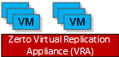
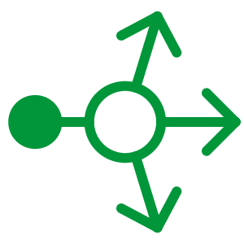
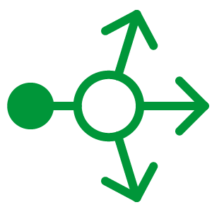
ZCC Traffic Flow for ICDR and DRaaS
Customer A
All traffic is bi-directional
4007 / 4008
CSP
9082 / 9083
9084 / 9085
ZCC A
9082 / 9083
9084 / 9085
9086 / 9087
9088 / 9089
4007 / 4008
4007 / 4008
4007 / 4008
Customer B
4007 / 4008
4007 / 4008
9082 / 9083
9084 / 9085
9086 / 9087
ZCC B
9082 / 9083
9084 / 9085
9086 / 9087
9088 / 9089
4007 / 4008
4007 / 4008
4007 / 4008

Slide 17

The purpose of the ZCC is to provide CSPs with support for overlapping IP ranges in end-customer environments

Slide 18
Core Implementation
The ZCC acts as a network proxy between the CSP entities (ZVM + VRAs) and the end-customer entities
Two NICs: one in the CSP’s network (eth0) and one in the customer’s (eth1)
Connecting to the customer’s network implies a VPN
The ZCC serves a variable number of entities, and therefore handles multiple ports
One ZCC per end-customer-ZVM

Slide 19
Core Implementation – Conceptual View – Zoom In
A ZCC port is “mapped” to an address + port of an entity (ZVM / VRA)
The customer VRA only connects to the “customer side” address of the ZCC
Customer
CSP
ZCC
9081
9081
ZVM
VRA
9082
4007
VRA
9084
4007
VRA

Slide 20
Core Implementation – Packet Flow
The ZCC relies on Network Address Translation / Port Address Translation (NAT/PAT) for achieving its goal
Implemented by iptables (Linux user-space command-line tool for configuring the Linux kernel firewall)
Two NAT rules are applied as a packet is processed: Destination NAT (DNAT) and Source NAT (SNAT)

Slide 21
Core Implementation – Extra Credit…
Q: Packet leaves the ZCC and reaches CSP VRA. How is the reply sent back? Where is the rule that maps port 10112 back to the customer VRA?
A: The Linux firewall is stateful: it allocates a port when a TCP connection is established, and remembers it for the lifetime of the connection.
10.0.0.2
172.16.2.3
ZCC
10.0.0.3
172.16.1.5
9082
From: 172.16.2.3:10112
To: 172.16.1.5:4007
4007
VRA
VRA

Slide 22
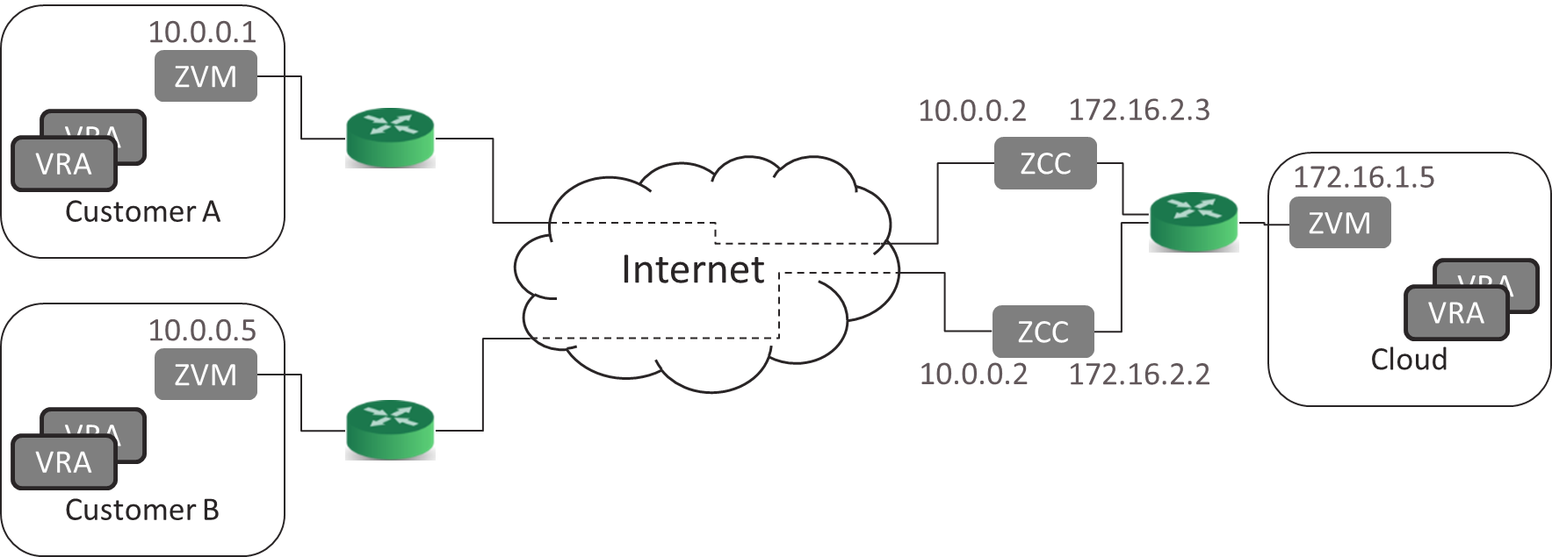
Core Implementation
The ZCC lets CSPs support end-customers with overlapping IP subnets
One ZCC per end-customer-ZVM
ZCC has two NICs: one in the CSP’s network, the other in the end-customer’s
Packets forwarded through DNAT and SNAT rules
DNAT rule - eth1:9082 -> 172.16.1.5:4007
SNAT rule - eth0 -> 172.16.1.3:10000-60000
One port on the CSP NIC for each entity-port on the customer side, and vice-versa

Slide 23
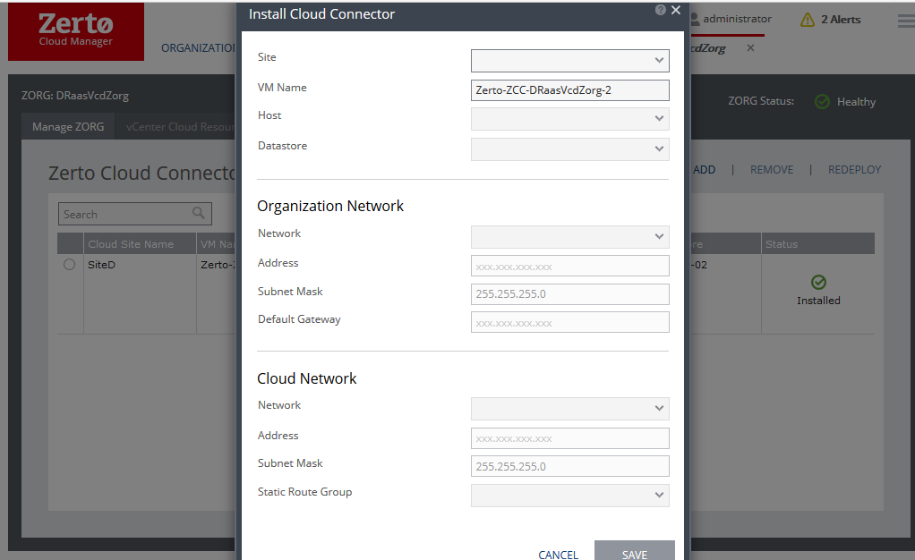
ZCC Flows – Installation
ZCC installation is initiated from the ZCM in DRaaS scenarios
Performed in the context of a specific ZORG
User must select a (cloud) site, i.e. a ZVM, in which the ZCC will be installed

Slide 24
ZCC Flows – Installation
Installation flow:
Deploy ZCC OVF with bootstrap disk:
Configure network parameters
Block SSH from customer side
Configure SNAT rule in both directions
Starting Balvenie: inject ZVM’s public key to allow SSH without credentials
(Not a complete list)
Configure vShield for vCD
Power on
Configure over SSH initial DNAT rule: eth1:9081 -> CloudZVM:9081
ZCC is associated with a ZORG even before pairing

Slide 25
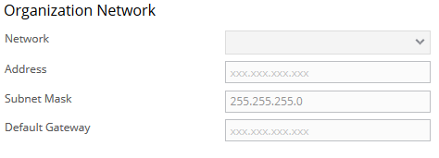
ZCC Flows – Installation
On the Customer (Organization Network) side, the CSP can configure a default gateway

Slide 26
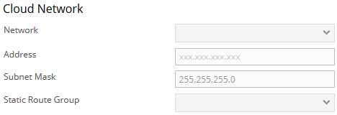
ZCC Flows – Installation
On the CSP (Cloud Network) side, the CSP can configure a static route group

Slide 27
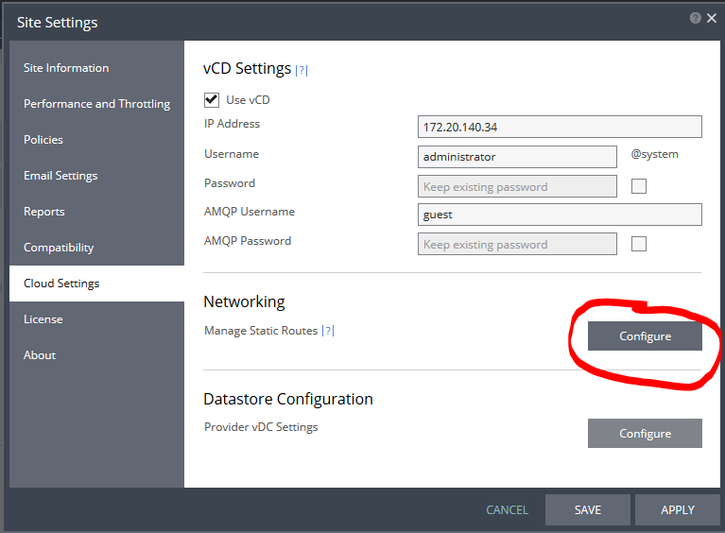
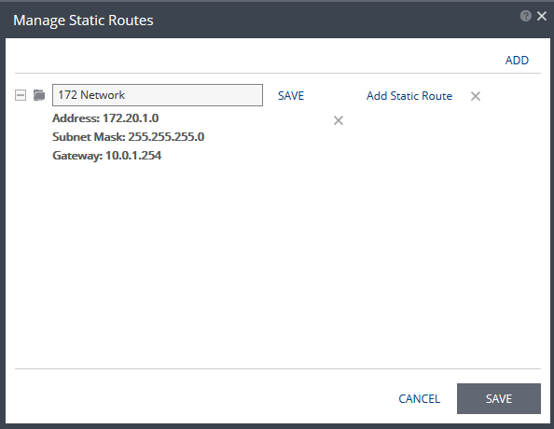
ZCC Flows – Installation – Routing
Static Route Groups are sets of routing rules that can be applied to ZCCs
Static Routes are configured from Site Settings

Slide 28

ZCC Flows – Installation – Routing
In the installation workflow, a default gateway applies to the end-customer network while static route groups apply to the CSP’s network
Q: In the ZCC network configuration, what ties the route groups to eth0 (the NIC on the CSP-side)?
A: Nothing! The default gateway can just as well belong to the CSP’s network, and the static route groups can belong to the end-customer’s network
… but this is against convention.

Slide 29
ZCC Flows – Installation - Failures
In case of a failure after the deployment of the OVF, the ZCC VM is not cleaned up and the ZCC in an “Orphaned” status
The most common cause for this is failure of the ZVM to SSH to the ZCC in order to configure the rules
Leaving the ZCC VM alive allows the CSP to perform network troubleshooting to track down the problem
An Orphaned ZCC can only be uninstalled

Slide 30

ZCC Flows – Installation – vCD
With vCD, customers set up a VPN to connect their on-premise network to their org vDC network. The ZCC will then connect to the org vDC network:
10.0.0.2
172.16.2.3
172.16.1.5
Cloud
ZCC
ZVM
Customer A
10.0.0.1
VRA
ZVM
VPN GW
VRA
VRA
VRA
Internet
VPN GW
…
VM
VM
VM
Customer VMs

Slide 31
ZCC Flows – Installation – vCD
During ZCC deployment we still list only VC portgroups
Due to the vCD naming scheme, they can easily(?) be mapped to the corresponding org vDC network

Slide 32
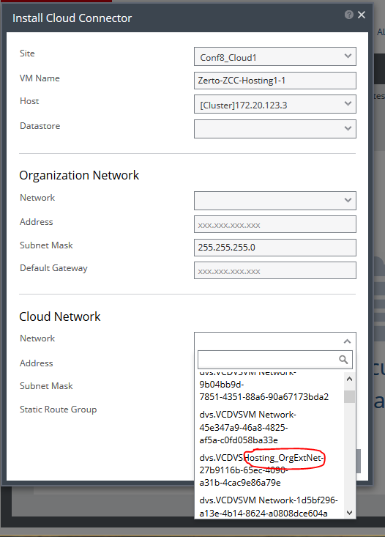
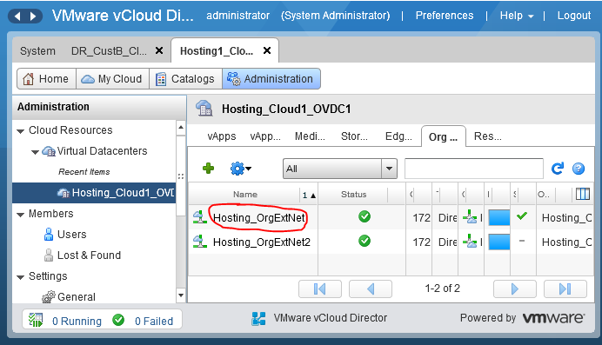
ZCC Flows – Installation – vCD

Slide 33
ZCC Flows – Installation – vCD
Q: Is this really how CSPs running vCD with many customers select the correct network during ZCC deployment?
A: Yes!

Slide 34
ZCC Flows – Installation – vCD (extra credit)
Org vDC networks in vCD are ultimately portgroups in VC, but they are isolated by VCNS / NSX:
10.0.0.2
172.16.2.3
172.16.1.5
Cloud
ZCC
ZVM
Customer A
10.0.0.1
VRA
ZVM
VPN GW
Unisolated portgroup
VRA
VRA
VRA
Internet
VPN GW
…
VM
VM
VM
Org vDC network
Isolated portgroup
Customer VMs

Slide 35
ZCC Flows – Installation – vCD (extra credit)
Connecting the ZCC to an isolated portgroup will still not(!) let it see the traffic going through the portgroup
We need to attach the ZCC to the “virtual network ID” (virtual wire in VXLAN)
This requires knowing the virtual network ID and adding fields to the ZCC’s VM configuration in the MOB
How can we learn the virtual network ID?

Slide 36
ZCC Flows – Installation – vCD (extra credit)
We steal it from other VMs connected to the same network!
… so this won’t work if there are no VMs connected to the org vDC network
The MOB’s values can be found under the VM’s extraConfig and are called ethernet{0}.filter{1}.name / param0 / param1

Slide 37
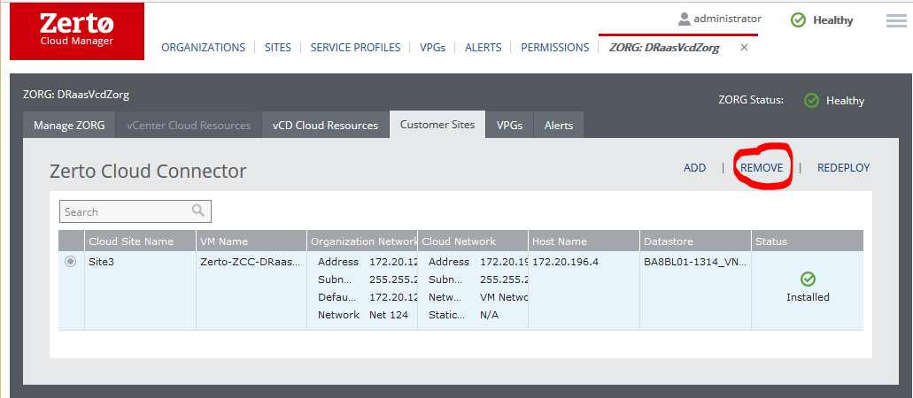
ZCC Flows – Uninstallation
ZCC uninstall is initiated from the ZCM
Uninstall removes the ZCC VM and clears it from the ZVM DB
Q: What happens if a site is paired through the uninstalled ZCC?
A: It loses connectivity, even if the ZCC is then reinstalled. Later we’ll see why.

Slide 38
ZCC Flows – Repair/Redeploy
If a ZCC VM is deleted from vCenter, the ZCC enters a Ghost state
A Repair operation can be initiated from the ZCM if the ZCC is ghosted
The user can change the host/datastore/network selections of the ZCC, but cannot change the ZORG association
After the new ZCC is deployed, all existing rules will be re-applied
Note: before 5.0u1, static route groups were not applied during Repair (bug 13646)

Slide 39

System Flows – Pairing
ZCC rules are required to pair a customer ZVM with a CSP ZVM, but…
… we can’t set up the rules without knowing the customer’s ZVM IP
… we can’t know the customer’s ZVM IP before it reaches the cloud ZVM!
Solution: A ZCC is born with one DNAT rule: eth1:9081->cloud_zvm:9081
Which connectivity does this enable?

Slide 40
System Flows – Pairing – cont’d
When a ZVM receives a pairing request, it checks whether this request comes from a ZCC IP
If so, it retrieves the peer ZVM’s IP from the ZCC and sets up the reverse DNAT rule (eth0:9081 -> cust_zvm:9081) before reaching out to the customer ZVM
It also associated the peer site with the ZCC’s ZORG
See:CloudConnectorManager.SetCustomerZvmIfHostIsCloudConnector, called by SiteOperations.ConnectAndValidate

Slide 41
System Flows – Pairing – cont’d
How does the cloud ZVM obtain the peer ZVM’s IP?
It connects to the ZCC and runs a netstat-nat command to find all active connections that are currently being routed through the ZCC
Which connection would you expect to find there?
Note: starting 5.0, netstat-nat is a script written by Zerto; not part of the OS
It then takes the first connection in the list and retrieves its source IP
… what could possibly go wrong?

Slide 42
System Flows – Adding a VRA
When a new cloud VRA is installed, a corresponding entry is added to all ZCCs belonging to the ZVM
When a new customer VRA is installed, a corresponding entry is added to the ZCC associated with the owning peer ZVM
See HostTracker.SetIPOnPeersOperation, AddPeerVraInfoTask.AddPeerVraInfoTaskFunc, PeerVraInfoSynchronizer.Synchronize, and RemoteSynchronizer.GetLocalVraInfo.

Slide 43
System Flows – Adding a VRA
To decide on a port to use, the system takes the highest used port number and adds 1 (ports are not recycled!) – see PersistentNatTable.AddPortMapping.

Slide 44
Implementation Details – Connectivity
The cloud ZVM uses SSH to connect to the ZCC and configure it
Before Balvenie, hard-coded credentials were used (root/zertodata)
Starting Balvenie, public-key-based authentication is used by default
Excluding netstat-nat, all scripts and commands sent to the ZCC are configured by the ZVM (i.e. no scripts on the ZCC). See CommandLineScriptProvider and its inheritors.
Anyone remember what netstat-nat does?

Slide 45
Implementation Details – State
The ZCC is stateful: any rule changes are persistently stored, in the ZCC, using iptables-save (serialize to a file)
When the ZCC boots, it loads the rules from the serialized file using iptables-restore
There is no rule synchronization mechanism between the ZVM and ZCC
If you want to force a resync, delete the ZCC VM from VC (don’t uninstall the ZCC!) and redeploy

Slide 46
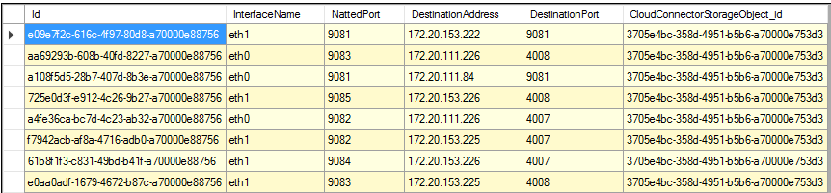
Implementation Details – Database Tables
CloudConnectorStorageObject – list of ZCCs and their settings
CloudConnectorRouteStorageObject – list of routing rules
CloudConnectorStaticRouteStorageObject – stores static route groups

Slide 47
Implementation Details – Uninstalling a ZCC
Q: If a ZCC is uninstalled and reinstalled (with the same parameters), why isn’t connectivity restored?
A: Because the new ZCC is born with a eth1:9081->cloud_zvm:9081 rule, but no rule going back from cloud to customer.
Manually adding the rule to the ZCC (and ZVM DB) should restore connectivity because the VRA IPs will be automatically sync’ed by the ZVMs

Slide 48
Implementation Details
Relevant classes
Installation: CloudConnectorInstaller, InstallCloudConnectorTask, CloudConnectorBootstrapScriptProvider
Ongoing work: ActiveCloudConnector, PersistentNatTable, CloudConnectorSshConnectionFactory

Slide 49
Troubleshooting
During log collection, the ZVM runs a bunch of troubleshooting commands on all ZCCs, resulting in a cloudconnectors.txt file containing:
ifconfig output (NIC configuration)
Dump of iptables rules (same verbose format we saw earlier)
Output of netstat / netstat-nat
Output of route (routing table)
This is incredibly useful – use it!
Note: duplicate rules are not a problem (but they are a bug)

Slide 50
Troubleshooting
Q: If pairing through a ZCC fails, which connectivity tests should you run?
A: Several:
From the ZCC, ping cloud ZVM
From the ZCC, ping customer ZVM
From the customer ZVM, telnet to ZCC’s customer leg on port 9081
But do not:
From the cloud ZVM, telnet to ZCC’s cloud leg on port 9081
From another customer machine, telnet to ZCC’s customer leg on port 9081
Why?
Notes:
No point telnet’ing to the cloud leg on port 9081, because the only rule that exists is eth1:9081 -> cloud_zvm:9081. The ZCC isn’t listening on port 9081 of the cloud leg, and it’s not forwarding the traffic, either.
If you telnet to customer_leg:9081 from another machine, you’ll reach the cloud ZVM and *create a connection on the ZCC*. When you then pair again, the “customer ZVM IP detection mechanism” can get confused! If this happens, easiest thing is to delete the ZCC and redeploy. If you made this mistake, you will see in the logs of the cloud ZVM that it wrongly detects the customer ZVM IP address.

